Slide 1
Hospital Workflow Documentation

Slide 2
Project Overview
Hospital workflows are designed to ensure efficient and effective patient care while managing resources and maintaining high standards of medical practice.
Patients were admitted in specific years, with doctors offering timely assessments and overseeing overall productivity.
Doctors recommended various tests, and patient ratings aided in gauging hospital efficiency, contributing valuable insights to enhance operations.

Slide 3
Hospital Process Planning Infographics
03
02
01
Enhance doctor-patient communication and satisfaction by leveraging patient ratings to continually assess and enhance hospital efficiency
Create guidelines for recommending medical tests based on patient needs and clinical standards to enhance diagnostic efficiency and care outcomes.
Using BI to track and analyze patient admission data alongside doctor assessments and productivity to identify areas for improvement.

Slide 4
Preprocessing using BI
02
03
Remove Error and Blank
Used DAX Expressions
01
04
Data Understanding
Generate Visuals

Slide 5
Insights
Case A
In 2023, the number of patients increased compared to 2022, but it decreased again in 2024.
Case B
Patient mostly affected by Flu & Viral Infection mostly in 2023.
Approximately 50% of patients stay in private rooms.
Case C
Case D
Naresh Goyenka suggest patient to stay longer in hospital & Niki Sharma suggest patient to stay for less period of time according to patient diagnosis.

Slide 6
Insights
Case E
X-ray generate less bill compare to other test.
Out of 284 diagnosed patients with fractures, only 34 were recommended by the doctor to undergo an X-ray.
Case F
Doctors are recommending that the patient prioritize having a blood test and an MRI over other tests.
Case G
Case H
Understand why doctors gets less rating and make improve in that segment.

Slide 7
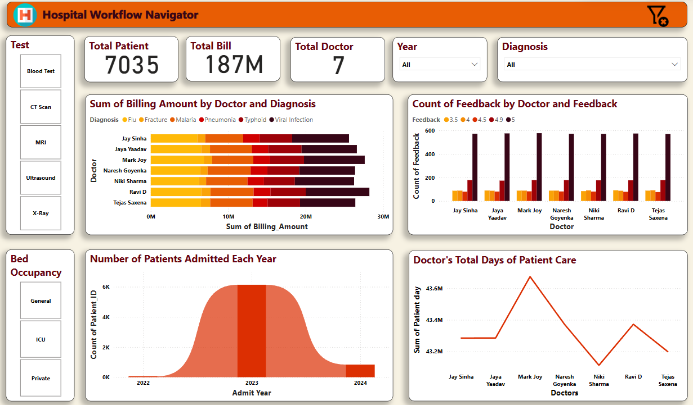
Dashboard
01
02
03
04
Jupiter
Mercury
Venus
Saturn
Jupiter is the biggest planet
It’s the closest planet to the Sun
Venus has a beautiful name
It’s a gas giant with rings

